Slide 1
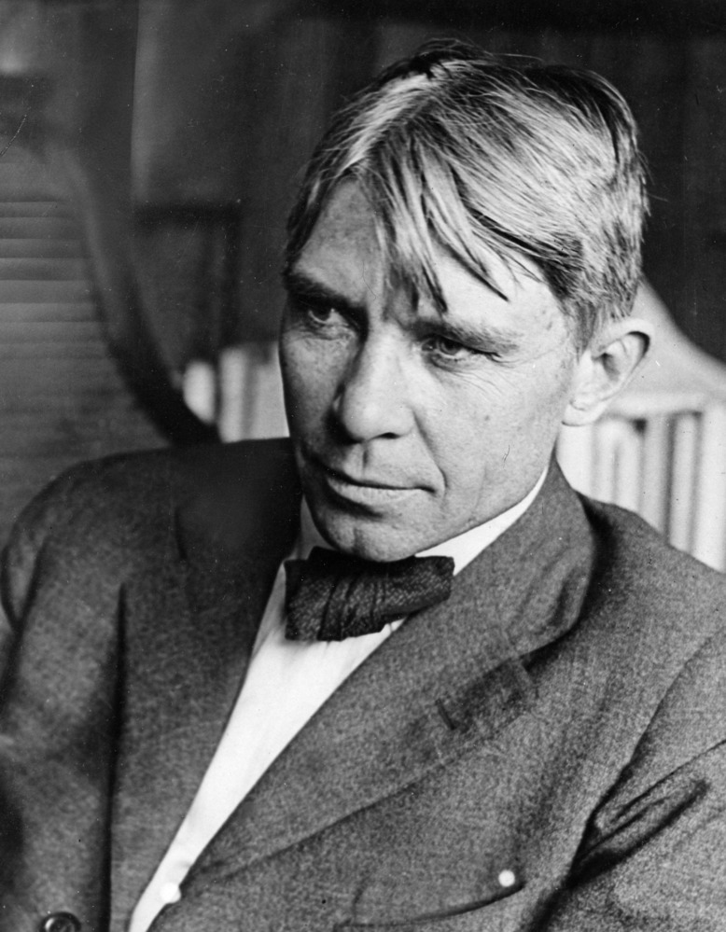
"Poet of the People“
Carl Sandburg provided a popular voice for the American people of the twentieth century and still speaks to us through his words, activism, music and the beauty and serenity of Carl Sandburg Home National Historic Site.
www.nps.gov/carl

Slide 2
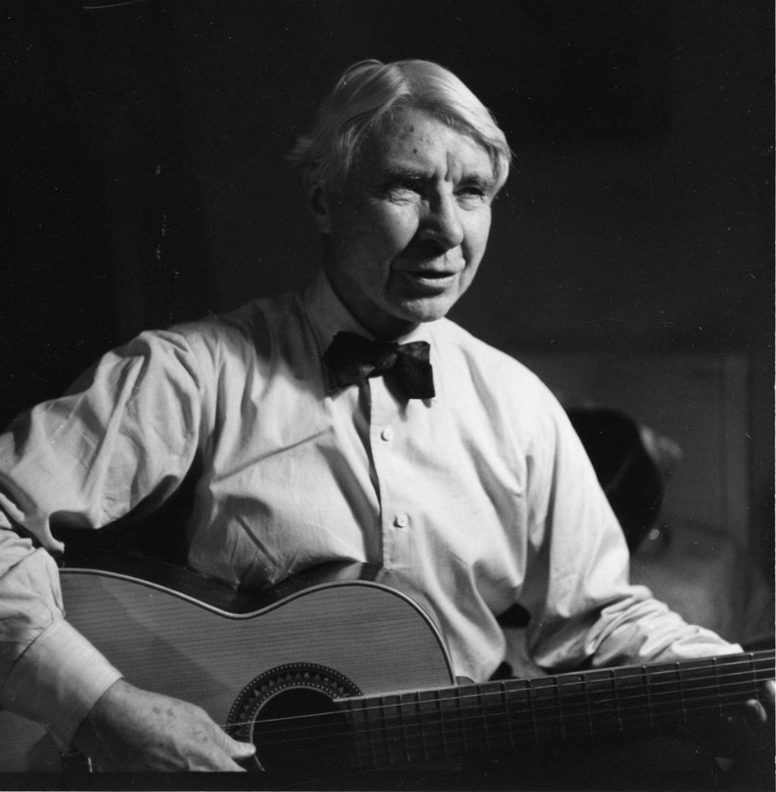
Performance Poetry
Too often students study poetry on the page, missing the important components of sound, rhythm, and tone. As an example, Carl Sandburg once famously defined poetry as the “synthesis of hyacinths and biscuits.” There is music in that line—and it becomes apparent when the words are read aloud: the repeated “s” sounds coupled with the near-perfect iambic pentameter result in a line that begs to be spoken.
Tasks:
Watch the video “Where to? What next?” to learn about Carl Sandburg’s poetry and hear examples of students sharing their poetry.
Watch an example of performance poetry and think about how the speaker used expression and body language to emphasize the words in the poem.
Choose one of Carl Sandburg’s poems or select a poem that speaks to you and practice performing the poem.
Video yourself performing the poem to share with your teacher and classmates.

Slide 3
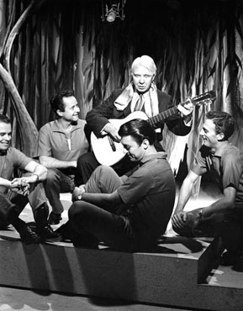
Click this link https://go.usa.gov/xfUrC to watch “Where to? What next?” and learn about Carl Sandburg’s poetry and hear examples of students sharing their poetry.
What does Glenis Redmond tell you about Carl Sandburg’s poetry?
What do you notice about the way that the students share their poems?
Write your response here….

Slide 4
Click this link https://www.youtube.com/watch?v=rtnEnEqjk0E&list=PLJbHvzUQw216z8zMuLfRRTPwv6vCgYeSr
to watch an example of performance poetry.
What do you notice about the performance?
How does the body language of the speaker help you to better understand the poem?
Write your response here….

Slide 5
Preparing to Perform
Choose one of Carl Sandburg’s poems from the following slides or select a poem that speaks to you to perform for your teacher and classmates.
Make sure you memorize the poem, thinking about how to use your voice expressively to convey the meaning and tone of the poem.
Think about your body language. How does that help your audience to understand the poem better?
Practice performing your poem. Make sure you speak clearly and make eye contact to engage your audience.
Video yourself performing the poem and share with your teacher.

Slide 6
Poem Choices by Carl Sandburg
SOUP
By Carl Sandburg
I saw a famous man eating soup.
I say he was lifting a fat broth into his mouth with a spoon.
His name was in the newspapers that day spelled out in tall black headlines
And thousands of people were talking about him.
When I saw him, he sat bending his head over a plate putting soup in his mouth with a spoon.
PRIMER LESSON
By Carl Sandburg
Look out how you use proud words.
When you let proud words go, it is
Not easy to call them back.
They wear long boots, hard boots; they walk off proud; they can’t hear you
calling—
Look out how you use proud words.
SLIPPERY
By Carl Sandburg
The six month child
Fresh from the tub
Wriggles in our hands.
This is our fish child.
Give her a nickname: Slippery.

Slide 7
More Poem Choices by Carl Sandburg
STUMBLING
By Carl Sandburg
Stumbling is where you walk and find you are not walking
Stumbling is where you find yourself spread on the ground, instead of standing on your feet
Stumbling is where your feet try to make a fool of you
Stumbling is to go where you are not looking when you mean to go where you are looking
Stumbling is to get your feet mixed so you go down
Stumblers are two kinds, those who come up quick and those who say, "Where am I?"
If you never want to stumble, be a fish or a bird.
JOY
By Carl Sandburg
Let a joy keep you
Reach out your hands and take it when it runs by
As the Apache dancer clutches his woman
I have seen them live long and laugh loud
Sent on singing, singing
Smashed to the heart under the ribs with a terrible love
Joy always
Joy everywhere-
Let joy kill you!
Keep away from the little deaths
MANNERS
By Carl Sandburg
Manners is how to behave Manners is when you know how to eat without being bashful
Manners is not afraid of what you are wearing
Manners is like a man tips his hat when he meets a lady
Manners is "EXUSE ME" OR "I BEG YOUR PARDON" instead of…
"HOW DO YOU GET THERE?" OR "I'LL KNOCK YOUR BLOCK OFF."

